Slide 1

62
Highway 62 Intersection Improvements
Public Information Centre
Detail Design and Class Environmental Assessment Study
GWP 4077-20-00
www.hwy62pec1.ca

Slide 2



Welcome to the
Public Information Centre (PIC)
The purpose of this PIC is to:
Sign In
• Present design details for the Recommended Plan
• Present information on construction staging
• Provide other project-related information
• Gather input on the project
• Answer questions about the design and construction of the project
Chat with Project Team
Additional information related to this PIC that is available on the project website includes:
A PDF copy of this presentation
A PDF copy of the Recommended Plan
Fill out a comment sheet
Use the QR Code to access the project website!
Let us know if you have any accessibility needs

Slide 3
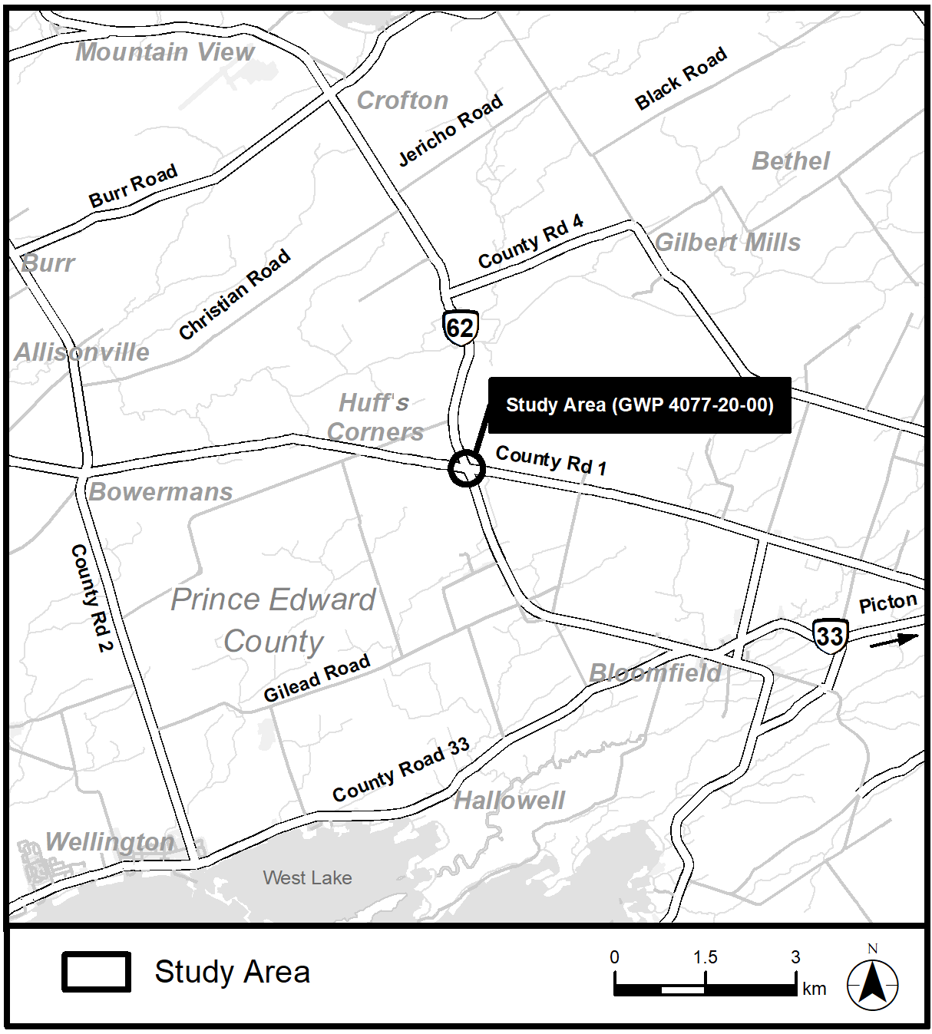
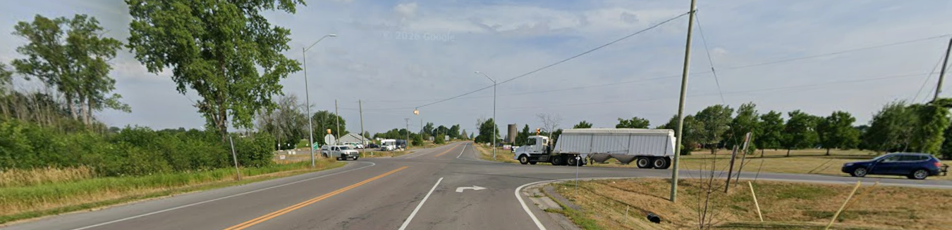
About The Project
The Ministry of Transportation (MTO) has retained Stantec Consulting Ltd. to undertake the Detail Design and Class Environmental Assessment (Class EA) for the intersection improvements at Highway 62 and County Road 1, in Prince Edward County.
The Preliminary Design and Class Environmental Assessment (Class EA) for intersection improvements at Highway 62 and County Road 1, completed in 2024, identified a roundabout as the Recommended Plan.
This Detail Design study will include design refinements to the roundabout Recommended Plan, development of construction staging plans, consultation, and development of environmental protection and mitigation measures.

Slide 4
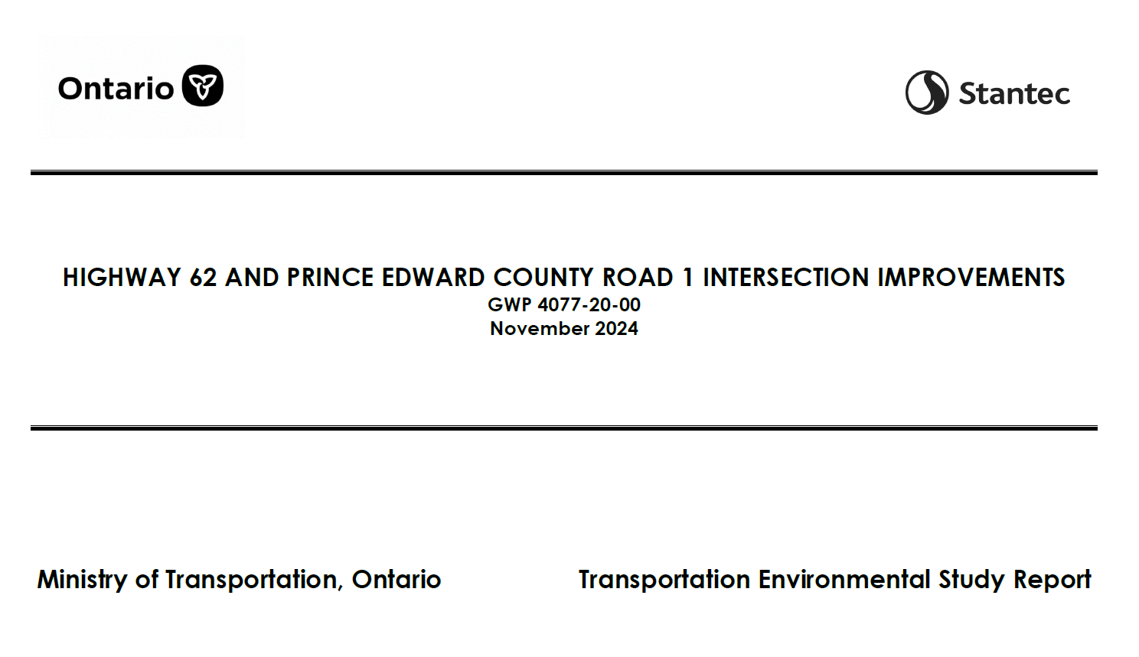
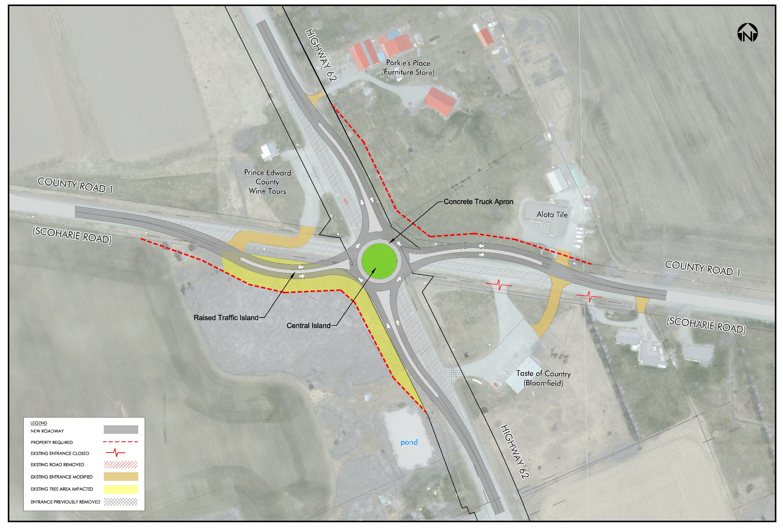
Project Background
In 2024, Stantec Consulting completed the Preliminary Design and Class EA Study. The study examined intersection improvements and was carried out in accordance with the approved environmental planning process for Group B Projects under the MTO Class Environmental Assessment for Provincial Transportation Facilities (2000). As part of the Preliminary Design study, a series of investigations were undertaken including natural environment, archaeology, contamination, traffic, and drainage.
The Preliminary Design and Class EA for intersection improvements at Highway 62 and County Road 1 developed a series of intersection alternatives, completed a detailed evaluation of alternatives, and identified a roundabout as the Recommended Plan. The study was documented in a Transportation Environmental Study Report (TESR, dated November 2024). The TESR received environmental clearance in February 2025.

Slide 5
What We Heard from Preliminary Design
Consultation was undertaken during the Preliminary Design and Class EA study and included two Public Information Centres, meetings with municipal staff and emergency service providers, agency and public consultation. Comments received have been summarized below.
Concerns regarding existing and future entrances to private properties and businesses
High frequency of car accidents at this intersection
Drivers not following the rules at the intersection
Safety concerns at existing intersection (i.e., speeding, traffic volumes)
Support to build a roundabout as soon as possible
Support for a roundabout
Would like to see landscaping at roundabout
Roundabout will need to accommodate large agricultural equipment

Slide 6
Existing Traffic and Safety Conditions
Traffic
Based on current traffic volumes, intersection improvements (roundabout) are warranted to improve operational performance.
Safety
Safety and collision data from 2017-2021 showed that majority of the collisions:
  involved a vehicle making a turn from the side road
  occurred from May to October
  resulted in a personal injury
A roundabout was selected as the Recommended Plan to address the identified traffic and safety concerns.
Benefits of Roundabouts:
Improved road safety due to lower vehicle speeds and the elimination of angle (side impact) collisions
Speed management
Increased capacity
Fewer stops and reduced delays
Less idling and air pollution

Slide 7


Class Environmental Assessment Process
Environmental Assessment Process
Ongoing Public Consultation
Ongoing Transportation
Needs Assessment
This study was originally initiated under the Class Environmental Assessment for Provincial Transportation Facilities (2000) in 2022, prior to the establishment of the 2024 Class EA, which is approved under the Ontario Environmental Assessment Act for provincial transportation projects of a defined scope and magnitude. This project will continue to follow the 2000 Class EA process.
The MTO Class EA process is an approved process for highway planning, design, and construction projects. The study is following a Group ‘B’ process, which includes major improvements to existing provincial transportation facilities.
At the end of the study, a Design and Construction Report (DCR) will be prepared and made available for a 30-day public comment period.
Detail Design
Consultation during Detail Design
Data Collection
Review available background information.
Conduct field investigations to update or confirm existing conditions from the Preliminary Design Study.
Study Commencement Notifications and project website (December 2025)
Newspaper Notice published December 18, 2025
Evaluate & Refine
Evaluate options for construction staging and traffic management.
Consider potential design refinements to the Recommended Plan developed during the Preliminary Design Study.
Public Information Centre
we are here
Identify
Identify the Recommended Plan and construction staging.
Identify mitigation measures to address potential impacts.
Design and Construction Report
30-day public comment period
Finalize
Complete Detail Design of the Recommended Plan to an implementation level of detail.
Report
Document the process leading to the Recommended Plan.
Consultation during Construction
Clearance
The Class EA requirements are met and the project is cleared to proceed to construction.
Future Stages
Construction is anticipated to begin in Spring 2027
Construction

Slide 8
Investigations
In accordance with the MTO Class Environmental Assessment process, this study includes engineering and environmental specialists who are carrying out background studies and site-specific investigations to support the Recommended Plan, and identify potential impacts and mitigation measures. The investigations for this study include, but are not limited to, the following:
  Engineering Investigations
    Traffic and Safety
    Drainage and Hydrology
    Highway
  Natural Environment Investigations
    Terrestrial
    Species at Risk
  Socio-Economic Investigations
    Businesses
    Archaeology
    Contamination
    Groundwater

Slide 9
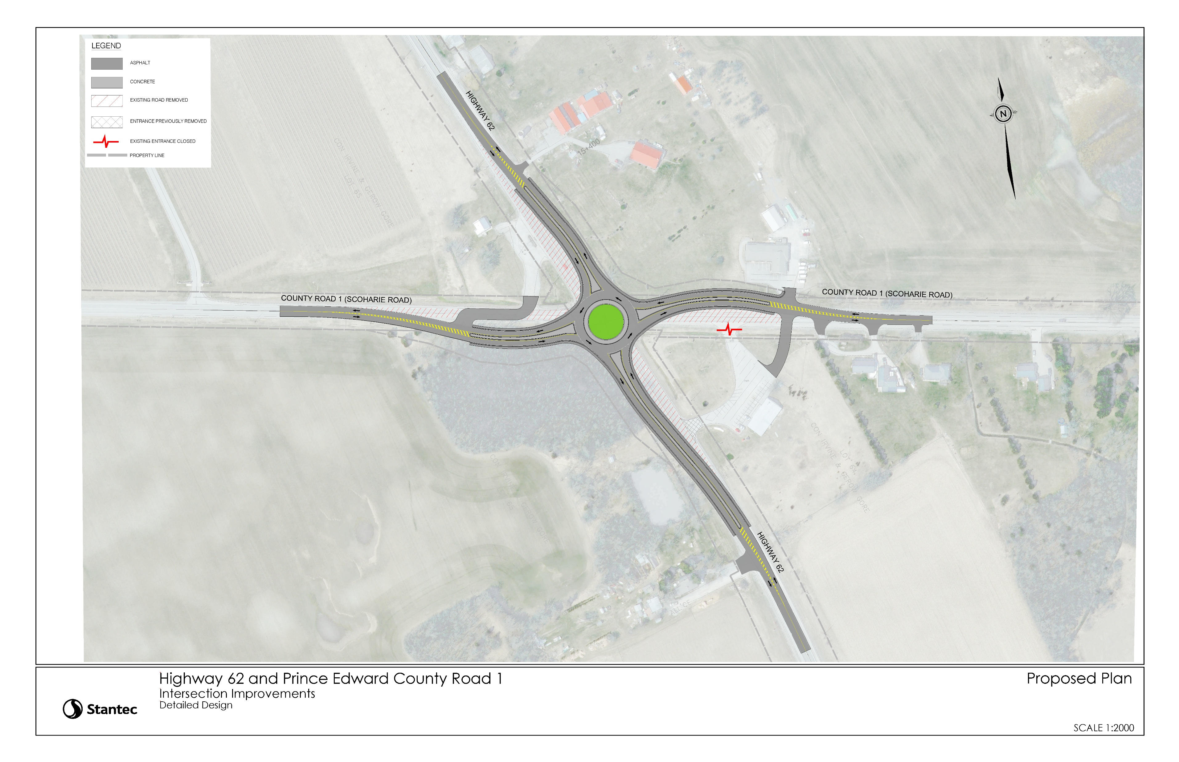
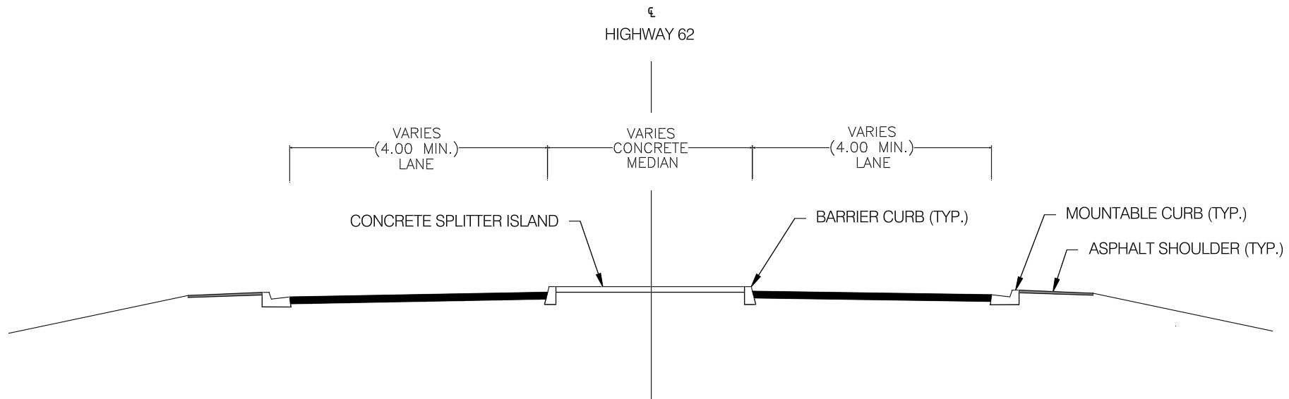
Refined Recommended Plan
The proposed design generally follows the preliminary design with some minor refinements. The refined Recommended Plan includes a mountable exterior curb with asphalt shoulder to accommodate large/farm vehicles.
Minor increase to the roundabout approach roadway curve radii compared to the Preliminary Design Plan to provide a more gradual deceleration for vehicle comfort when approaching the roundabout.

Slide 10
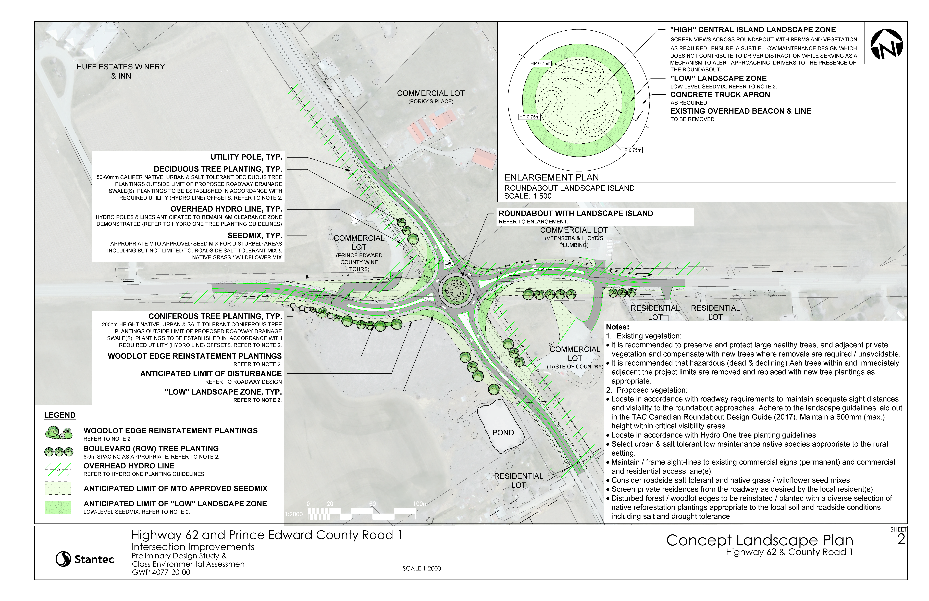
Conceptual Landscape Plan
SEED MIXES WILL BE REVIEWED WITH THE MINISTRY AND CONFIRMED IN THE FINAL LANDSCAPE PLAN.

Slide 11
Construction Staging and Traffic Management
Construction will require:
Lane shifts including temporary hot mix asphalt to provide additional width.
Daytime single lane closures with flagging to maintain two-way traffic.
Short duration overnight closures of the intersection may be required.
Access to adjacent properties will be maintained at all times during construction.
Advance signage will be in place throughout construction to notify the travelling public.
Construction is planned to commence in Spring 2027 and includes:
  Construction of a new single lane roundabout, including new advance signage and construction of new driveways/entrances to affected businesses
  Culvert replacements and reconstruction of ditches to new alignment to accommodate the roundabout
  Landscaping along approaches and in central island
  New illumination at the roundabout

Slide 12
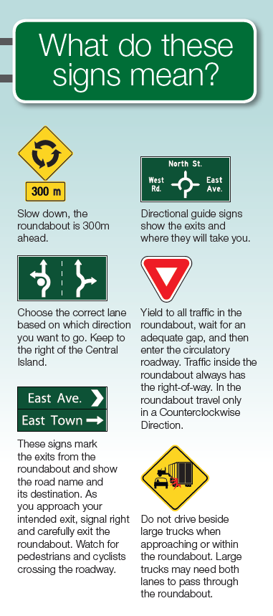
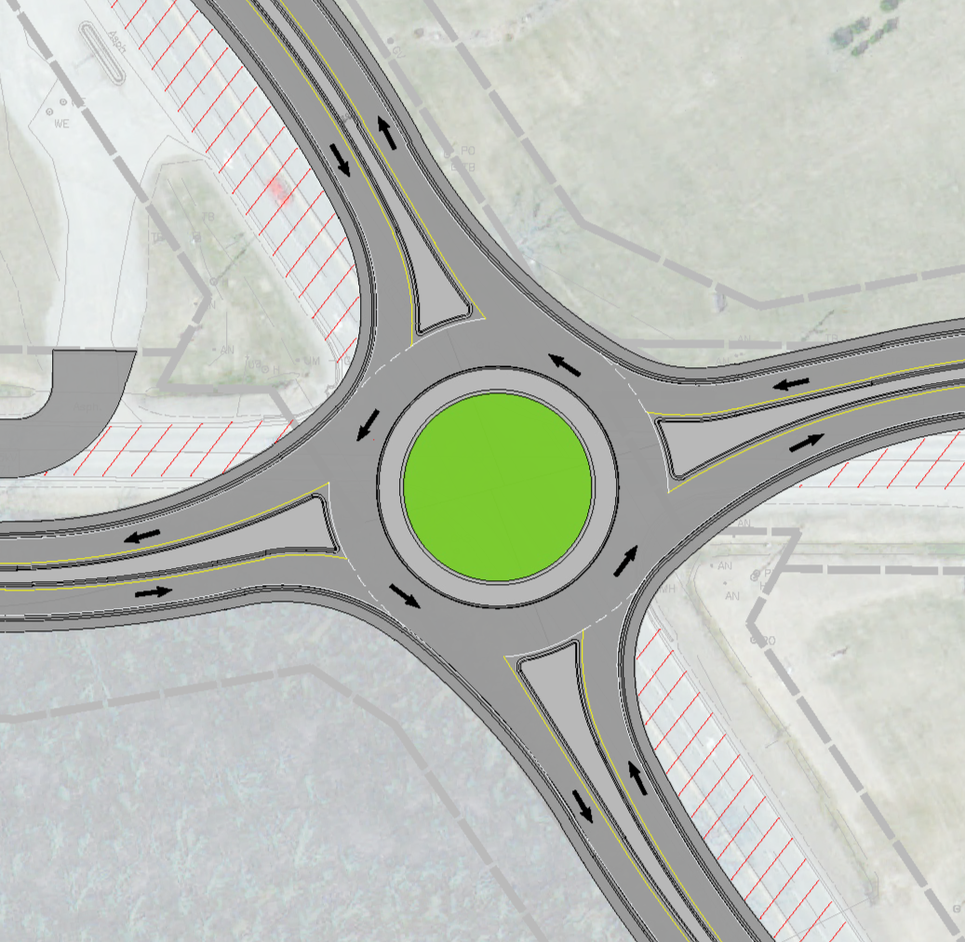
Roundabouts
What is a Roundabout?
A roundabout is an intersection at which all vehicular traffic circulates counter-clockwise around a central island. Drivers yield at entry and vehicles already in the roundabout have the right-of-way.
Splitter Island
How to Use a Roundabout:
Through Traffic: Yield to traffic in the roundabout, stay to the right and continue through.
U-Turn: Yield to traffic in the roundabout, stay to the right and continue around the roundabout and exit on the same road you entered on.
Left Turn: Yield to traffic in the roundabout, travel three-quarters of the way around the roundabout and make your turn.
Right Turn: Yield to traffic in the roundabout, stay to the right and complete your turn.
Central Island
Counterclockwise Direction
Yield Line
Truck Apron

Slide 13
Potential Impacts and Proposed Mitigation Measures During Construction
The Recommended Plan may result in potential impacts to existing vegetation and wildlife habitat, tree removal, property entrance changes, temporary traffic delays and other impacts. Proposed mitigation measures are presented below for each type of impact:
Property Access/Entrance Impacts
Proposed Mitigation Measures:
Maintain access to private entrances and sideroads during construction
Impacts to Terrestrial Environment
Proposed Mitigation Measures:
Timing restrictions for vegetation clearing
Minimize vegetation removal and damage
Registration and conservation plan for potential Species at Risk present, if required
Construction Noise and Air Quality
Proposed Mitigation Measures:
Noise mitigation measures for construction equipment, proper maintenance of equipment, and limit unnecessary noise and idling
Dust suppression and controls during construction and limiting exposed areas
Traffic Delays
Proposed Mitigation Measures:
Minimize traffic impacts through staged construction
Provide advance notification of construction start
Lane closures will be controlled by flag persons when workers are present and restored to two lanes when workers are not present
Archaeological Resources
Proposed Mitigation Measures:
If archaeological resources are encountered during construction, all activities impacting archaeological resources will cease and the Ministry of Citizenship and Multiculturalism will be contacted immediately
A Stage 1 and 2 Archaeological Assessment was completed and no resources were found.
Landscaping and
Vegetation Impacts
Proposed Mitigation Measures:
A detailed landscape plan will be developed and refined which documents impacts to vegetation and proposed restoration plans

Slide 14
Next Steps
The following tasks will be completed after this PIC:
Review, consider and respond to the comments received at and following the Public Information Centre
Refine construction and staging plans
Prepare and provide the Design Construction Report for Fall 2026
Construction is anticipated to take place in Spring 2027
What is a Design and Construction Report?
The Design and Construction Report will document the project’s final design and construction staging. It will document the recommended improvements, consultation undertaken, and potential environmental issues and mitigation measures associated with the Recommended Plan. The report will be made available on the project website at www.hwy62pec1.ca for a 30-day public and agency comment period.

Slide 15


Thank You!
Ways to provide your comments:
Visit the study website:
www.hwy62pec1.ca
Complete the comment form
Email comments@hwy62pec1.ca
Contact Project Team Members:
Mark McCulloch, P.Eng. Consultant Project Manager Stantec Consulting Ltd. 1331 Clyde Ave. #300, Ottawa, ON K2C 3G4 Tel: (613) 703-7724 comments@hwy62pec1.ca | Ben Goernert, P.Eng. Senior Project Engineer Ministry of Transportation Project Delivery East 1355 John Counter Boulevard, Postal Bag 4000 Kingston ON K7L 5A3 Toll-free: 1-800-267-0295 comments@hwy62pec1.ca
We would appreciate receiving your comments by September 16, 2026
Information will be collected in accordance with the Freedom of Information and Protection of Privacy Act. All comments will be maintained on file for use during the study and, with the exception of personal information, may be included in study documentation and become part of the public record.

